Slide 1

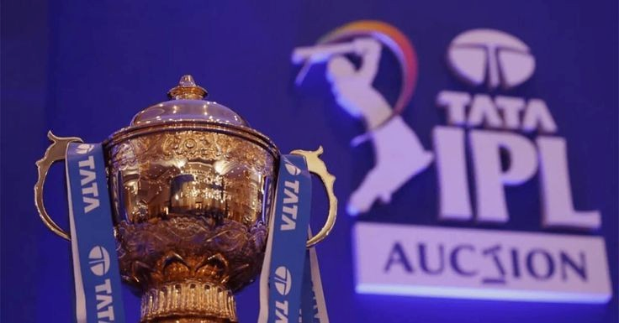
IPL AUCTION
Created by :
Vaishnavi Gupta
AUGUST 2024

Slide 2
CONTENT
MOTIVE
LIST OF 10 BATSMAN WITH HIGH BATTING STRIKE RATE WHO HAVE FACED ATLEAST 500 BALLS
LIST OF 10 PLAYERS WITH BEST AVERAGE WHO HAVE PLAYED MORE THAN 2 IPL SEASONS (OR 28 MATCHES)
LIST OF 10 PLAYERS WHO HAVE SCORED MOST RUNS IN BOUNDARIES AND HAVE PLAYED MORE THAN 2 IPL SEASONS(MORE THAN 28 MATCHES).
LIST OF 10 BOWLERS WITH BEST ECONOMY WHO HAVE BOWLED AT LEAST 500 BALLS IN IPL
LIST OF 10 BOWLERS WHO HAVE THE BEST STRIKE RATE AND WHO GAVE BOWLED AT LEAST 500 BALLS
LIST OF 10 ALLROUNDERS WHO HAVE THE BEST BOWLING AND BATTING STRIKE RATE AND WHO GAVE FACED AT LEAST 500 BALLS AND BOWLED AT LEAST 300 BALLS.
CRITERIA FOR SELECTING WICKETKEEPERS IN THE IPL
ADDITIONAL QUESTIONS

Slide 3
MOTIVE
Considered Factors For IPL Auction Analysis
All Rounder Players
Top Wicket Keepers
Bowlers with Best Strike Rate
Bowlers with Good Economy
Batsman With High Strike Rate
Batsman With Good Average
Hard Hitting Players
Developing auction strategy for new IPL franchise.
The goal is to analyze past IPL data to create a strong and balanced squad by selecting a right mix of players.

Slide 4
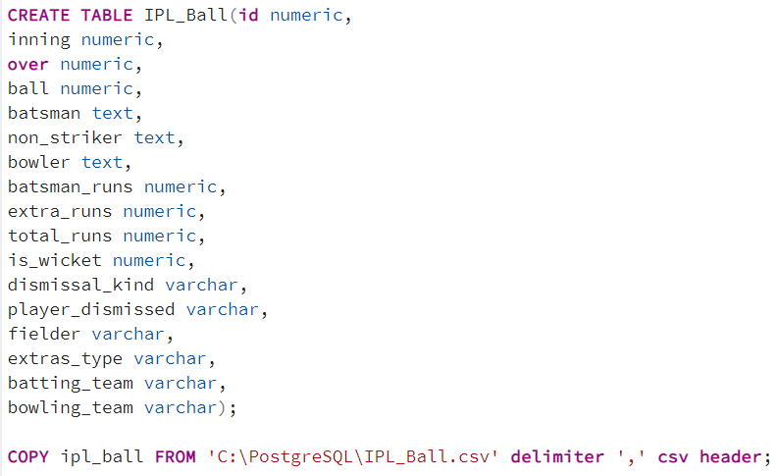
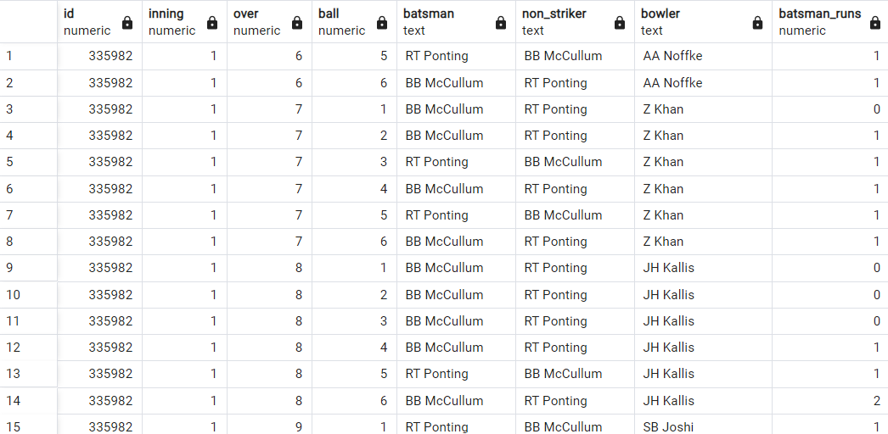
IMPORTING DATASETS
Datasets Used : IPL_Ball, IPL_matches
Tables Created : IPL_Ball, IPL_match
QUERY – Creating Table IPL_Ball
OUTPUT

Slide 5
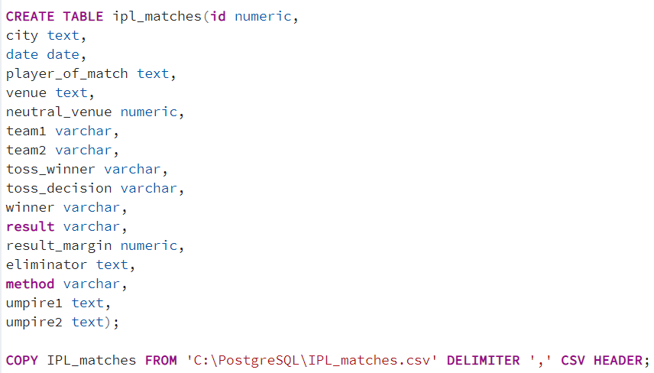
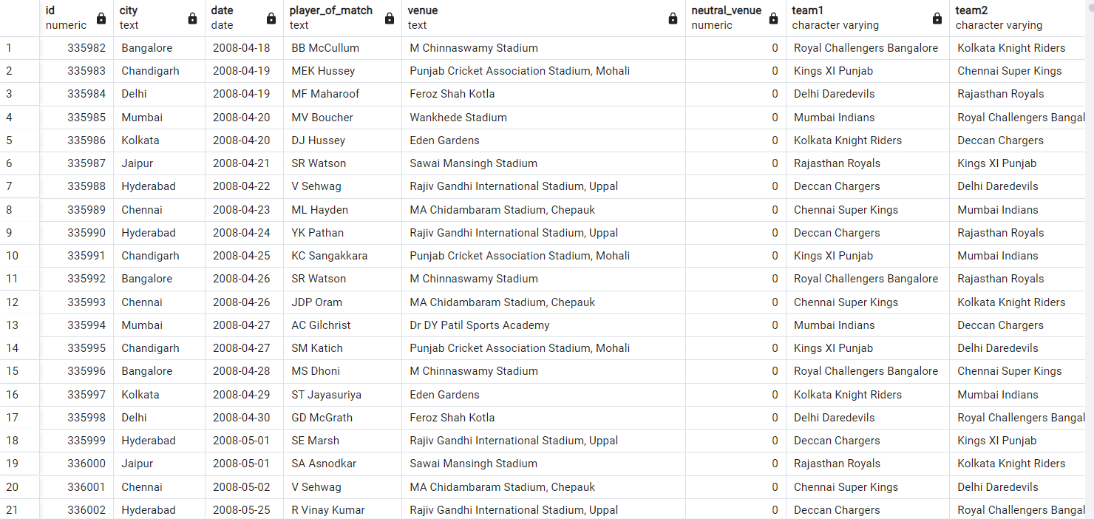
IMPORTING DATASETS
QUERY – Creating Table IPL_match
OUTPUT

Slide 6
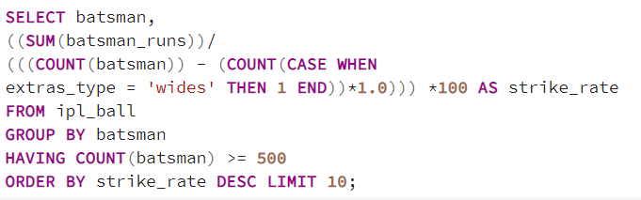
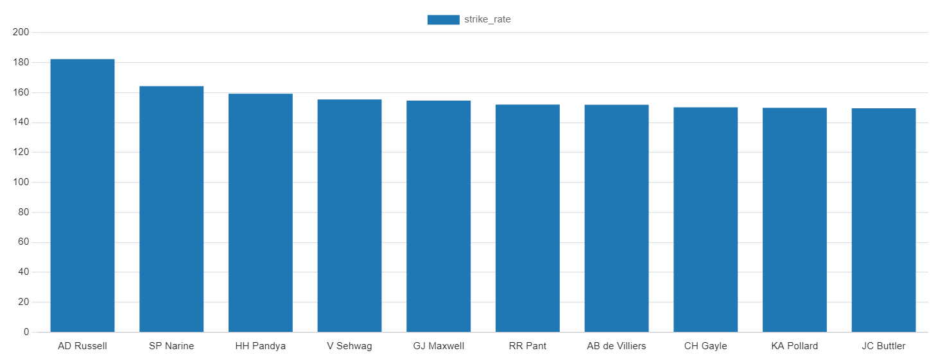
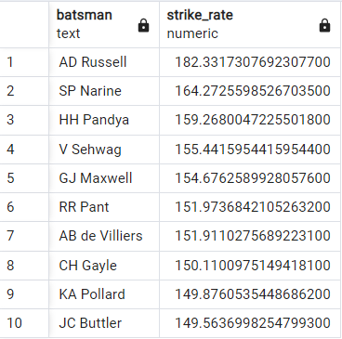
Q1
To get two 2-3 players HIGH STRIKE RATE who have faced at least 500 balls and to do that we have to make a list of 10 players we want to bid in the auction.
QUERY
OUTPUT

Slide 7
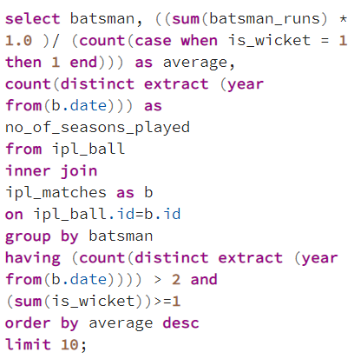
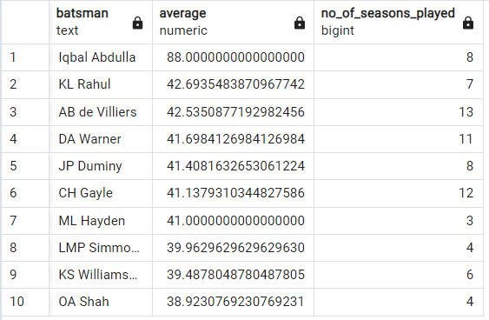
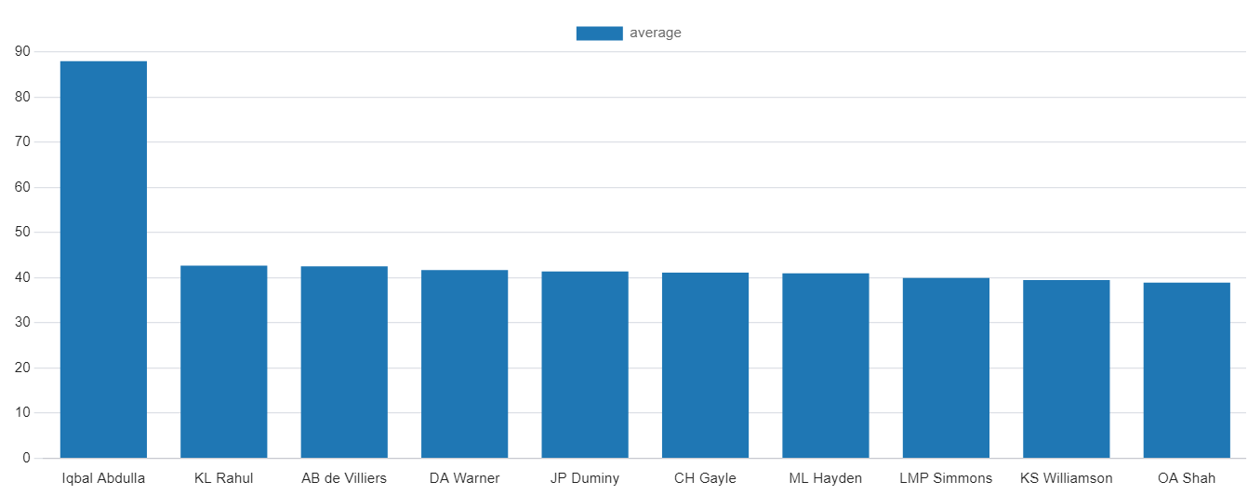
Q2
We need to get 2-3 players with GOOD AVERAGE who have played more than 2 IPL Seasons (OR 28 matches) & to do that we have to make a list of 10 players.
QUERY
OUTPUT

Slide 8
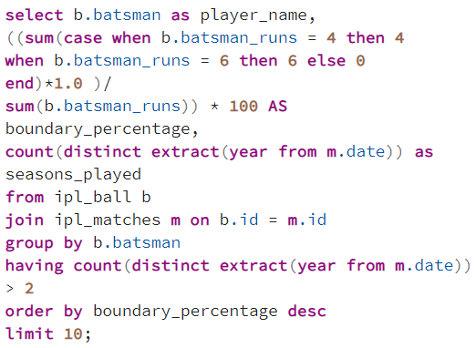
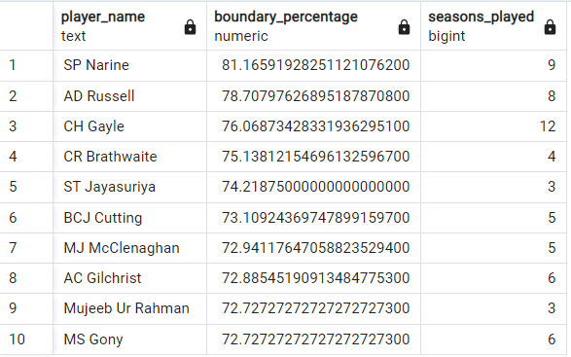
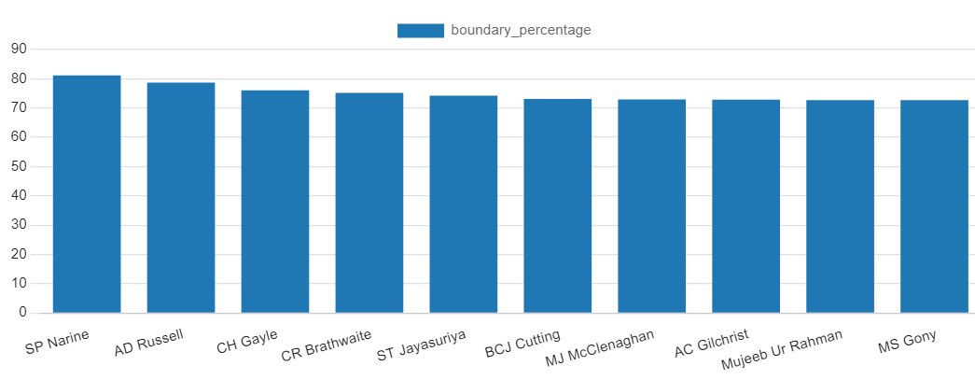
Q3
Top 10 players who have scored most runs in boundaries and have played more than 2 IPL Seasons (More than 28 matches).
QUERY
OUTPUT

Slide 9
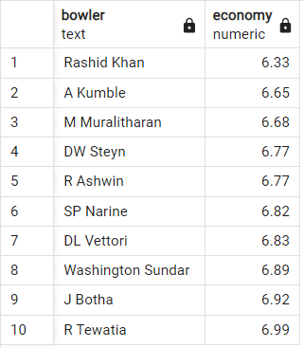
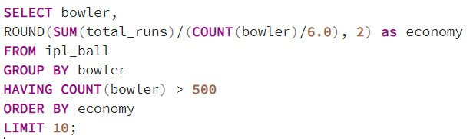
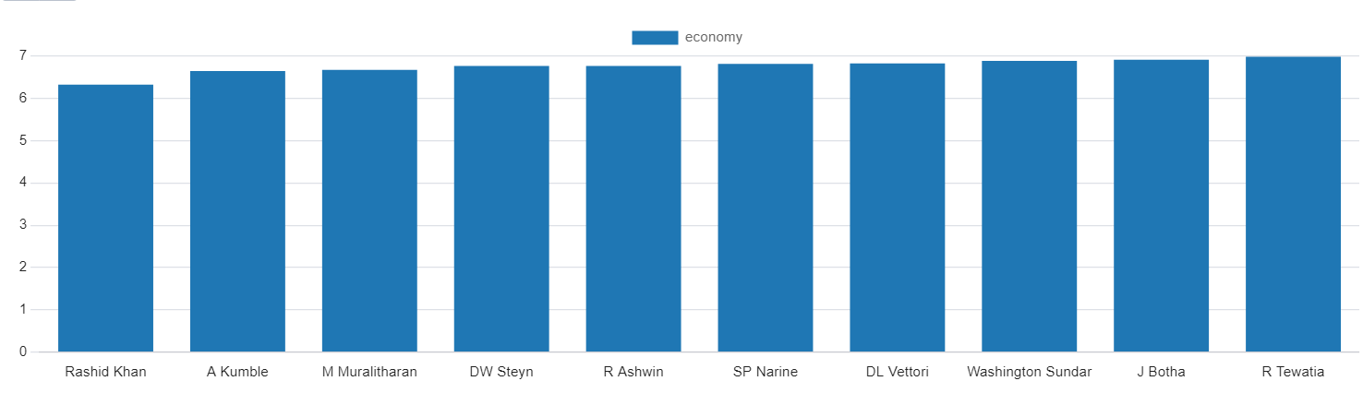
Q4
List of 10 BOWLERS with GOOD ECONOMY who have bowled at least 500 Balls in IPL.
QUERY
OUTPUT

Slide 10
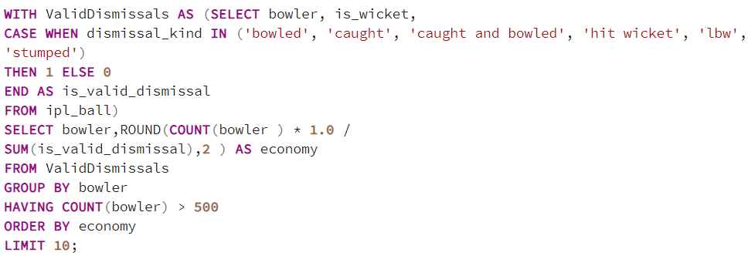
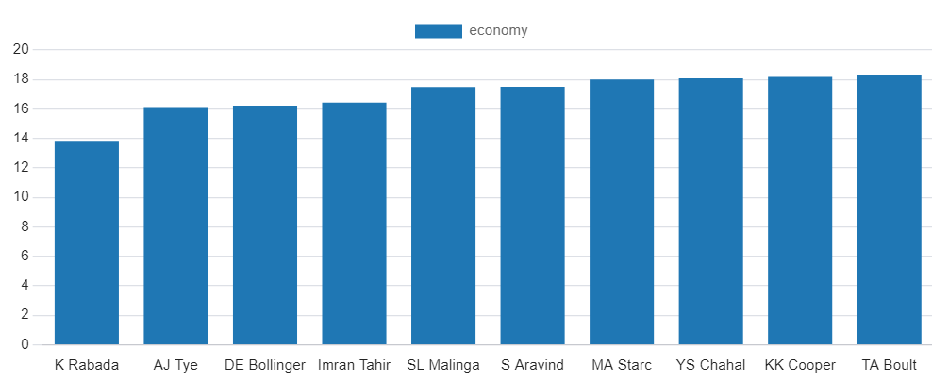
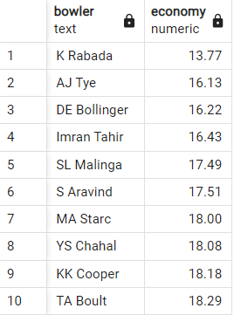
Q5
List of 10 bowlers who have the BEST STRIKE RATE and who have bowled at least 500 Balls
QUERY
OUTPUT

Slide 11
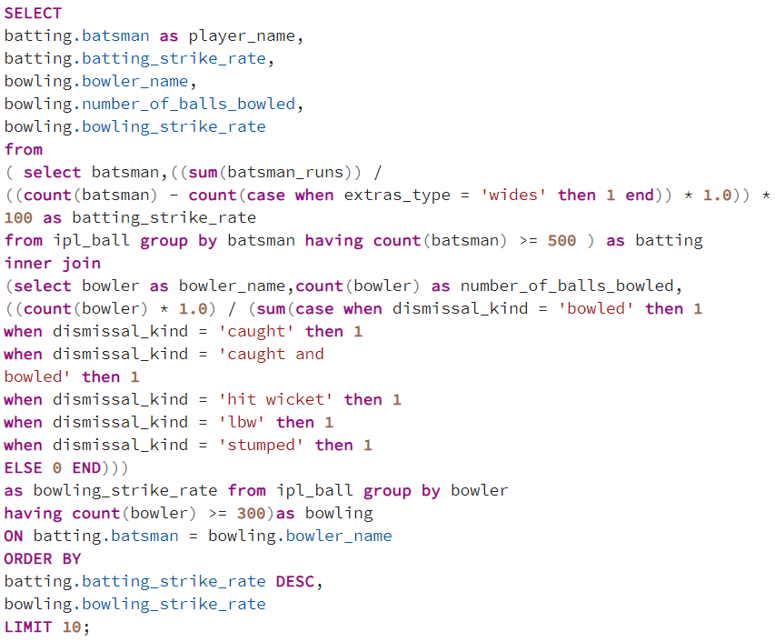
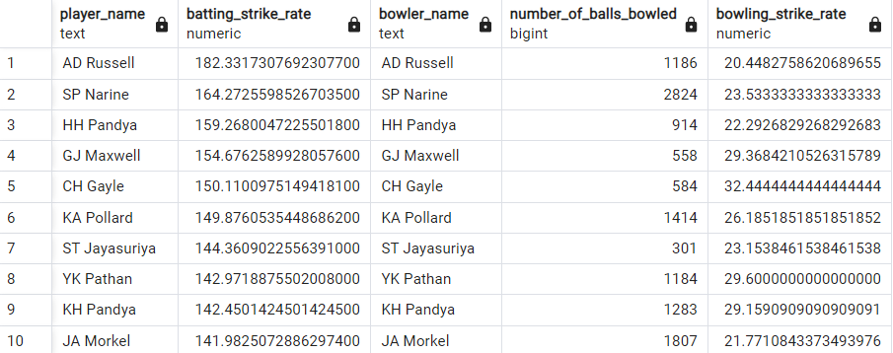
Q6
To get 2-3 ALL ROUNDERS with the BEST BATTING as well as bowling strike rate and who have faced at least 500 balls in IPL so far and have bowled minimum 300 Balls.
QUERY
OUTPUT

Slide 12
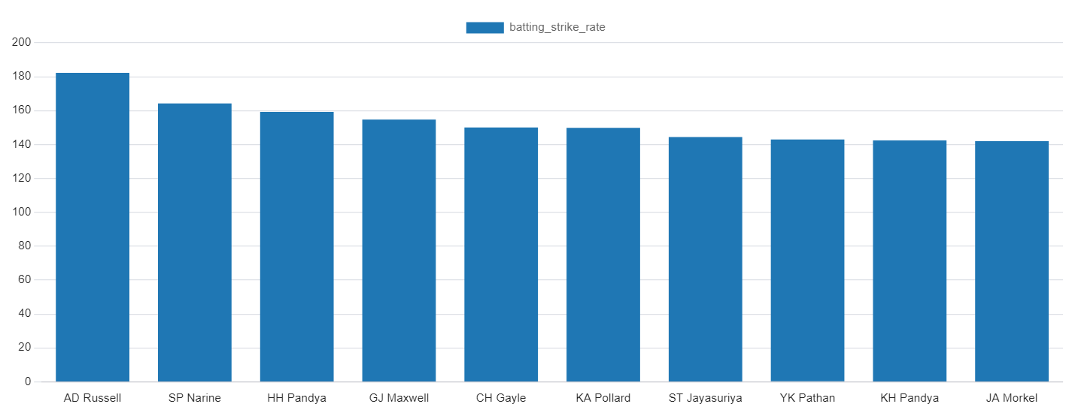
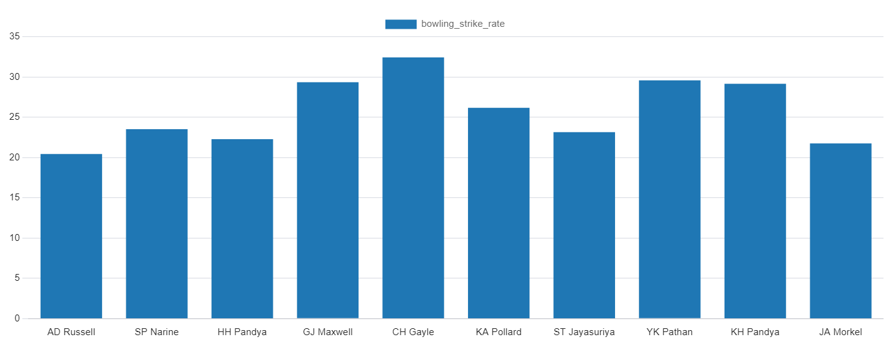
Batting_Strike_Rate
Bowling_Strike_Rate

Slide 13
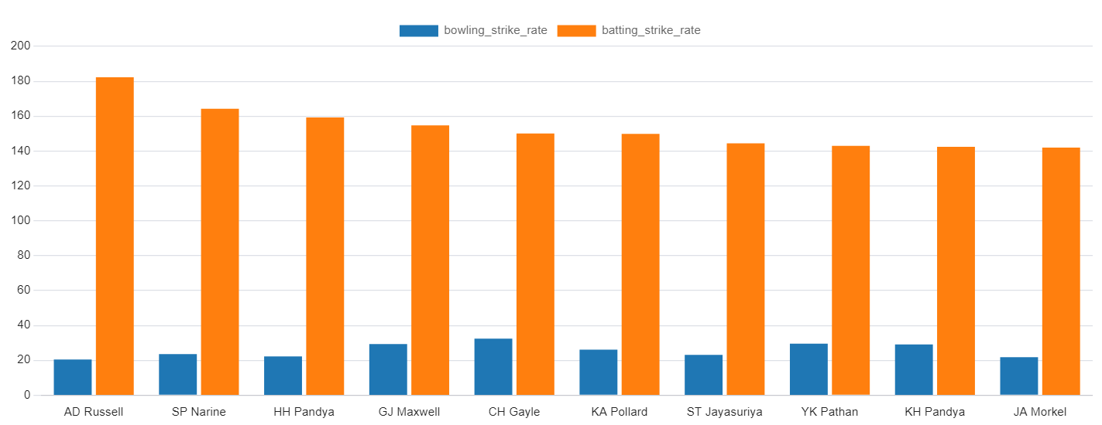
Comparison chart for both BATTING & BOWLING STRIKE RATE of players

Slide 14
Q7
Criteria for selecting WICKETKEEPERS in IPL
Criteria used:
Let's consider we have a list of wicketkeepers: W1, W2, W3, W4, W5, and so on. Now we have to evaluate each wicketkeeper based on the given criteria and assign a score to each criteria. The wicketkeepers with the highest cumulative scores will be considered as best wicketkeeper.
Batting Ability : Assign a score to each wicketkeeper based on their batting performance. We can use a scale of 1 to 10, where a higher score indicates better batting ability.
For example:
W1: Batting Ability = 8
W2: Batting Ability = 9
W3: Batting Ability = 7
W4: Batting Ability = 9
W5: Batting Ability = 8

Slide 15
Adaptability : Assign a score to each wicketkeeper based on their ability to adapt to different match situations and batting roles.
For example:
W1: Adaptability = 7
W2: Adaptability = 8
W3: Adaptability = 6
W4: Adaptability = 7
W5: Adaptability = 9
Fielding Skills : Assign a score to each wicketkeeper based on their fielding skills, including catching and stumping abilities.
For example:
W1: Fielding Skills = 9
W2: Fielding Skills = 8
W3: Fielding Skills = 7
W4: Fielding Skills = 6
W5: Fielding Skills = 8

Slide 16
Communication and Leadership : Assign a score to each wicketkeeper based on their communication skills and leadership qualities.
For example:
W1: Communication and Leadership = 6
W2: Communication and Leadership = 9
W3: Communication and Leadership = 8
W4: Communication and Leadership = 7
W5: Communication and Leadership = 7
Versatility : Assign a score to each wicketkeeper based on their ability to contribute with bowling (spin or medium pace).
For example:
W1: Versatility = 5
W2: Versatility = 7
W3: Versatility = 6
W4: Versatility = 9
W5: Versatility = 6

Slide 17
Consistency and Experience: Assign a score to each wicketkeeper based on their consistent performances and
experience in IPL .
For example:
W1: Consistency and Experience = 8
W2: Consistency and Experience = 9
W3: Consistency and Experience = 7
W4: Consistency and Experience = 8
W5: Consistency and Experience = 9
Now, based on these scores for each criterion, we can calculate the cumulative score for each wicketkeeper by
summing up the scores:
W1: Cumulative Score = 8 + 7 + 9 + 6 + 5 + 8 = 43
W2: Cumulative Score = 9 + 8 + 8 + 9 + 7 + 9 = 50
W3: Cumulative Score = 7 + 6 + 7 + 8 + 6 + 7 = 41
W4: Cumulative Score = 9 + 7 + 6 + 7 + 9 + 8 = 46
W5: Cumulative Score = 8 + 9 + 8 + 7 + 6 + 9 = 47
Based on these cumulative scores, we can conclude that W2, W5 are the top 2 wicketkeepers.

Slide 18
Explanation of each Factor Applied in order to find TOP 2 BEST WICKETKEEPERS
Batting Ability: Prioritize wicketkeepers who can score quickly and hit boundaries, contributing to the team's run total.
Adaptability: Strong wicketkeeping skills are vital. Look for wicketkeepers with quick reflexes, clean catching ability, and accurate stumpings.
Experience: Consider wicketkeepers with T20 experience who can handle pressure situations effectively.
Versatility: Choose wicketkeepers who can adapt to different match scenarios and contribute effectively in various batting positions.
Leadership and Communication: Wicketkeepers who can lead the fielding unit and effectively communicate with bowlers and fielders are valuable.
Fielding Skills: Prioritize wicketkeepers with excellent fielding skills, capable of creating run-out opportunities.
Consistency: Look for wicketkeepers with a consistent track record, both in batting and wicketkeeping, to ensure stable performance throughout the tournament.

Slide 19
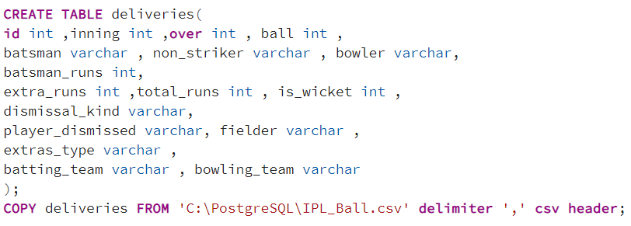
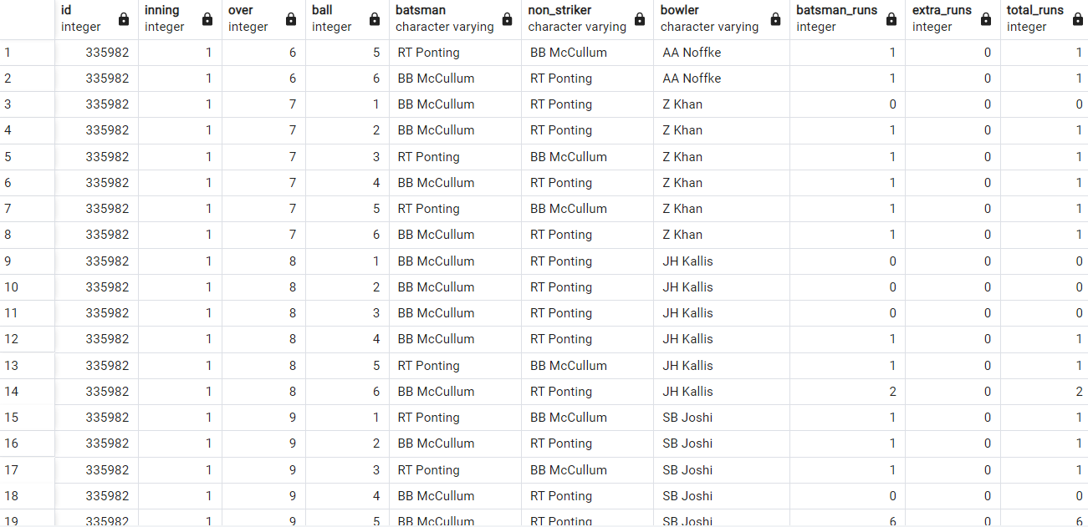
ADDITIONAL QUESTIONS
Query for creating table ‘deliveries’ :
OUTPUT :

Slide 20
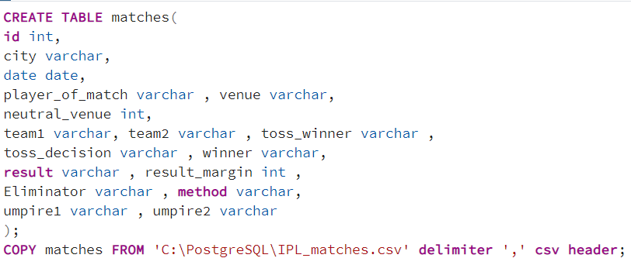
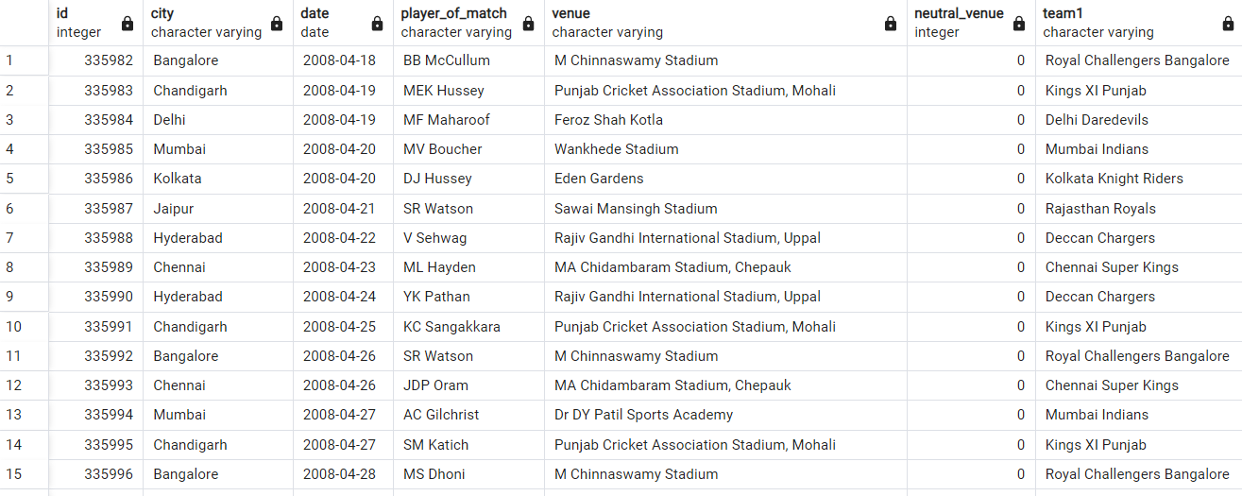
Importing datasets & Table Creation
Query for creating table ‘matches’ :
Output :

Slide 21

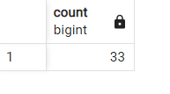
Q1
Get the count of cities that have hosted an IPL match
OUTPUT
QUERY

Slide 22
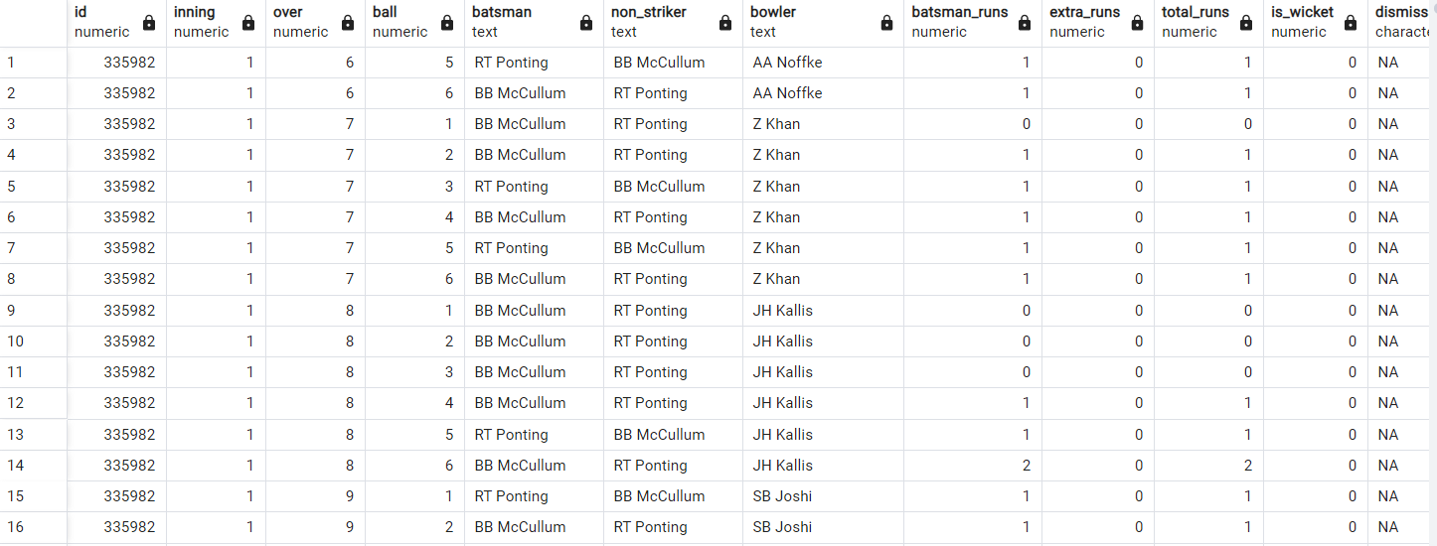
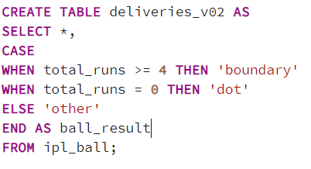
Q2
Create table deliveries_v02 with all the columns of the table ‘deliveries’ and an additional column ball_result containing
values boundary, dot or other depending on the total_run (boundary for >= 4, dot for 0 and other for any other number)
(Hint 1 : CASE WHEN statement is used to get condition based results)
(Hint 2: To convert the output data of the select statement into a table, you can use a subquery. Create table table_name
as [entire select statement].
QUERY
OUTPUT

Slide 23
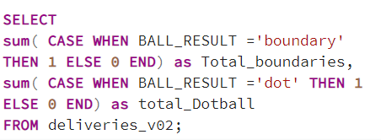
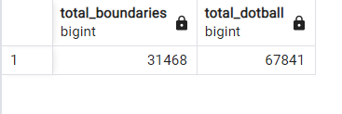
Q3
Write a query to fetch the total number of boundaries and dot balls from the
deliveries_v02 table.
QUERY
OUTPUT

Slide 24
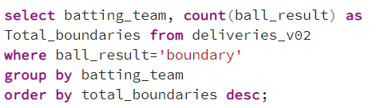
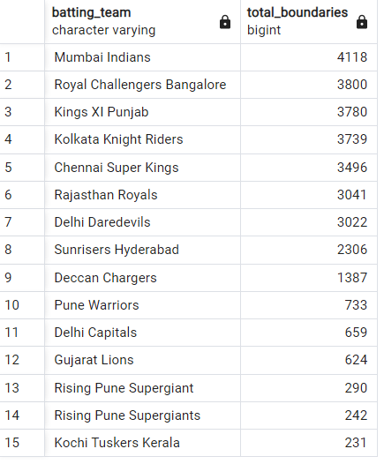
Q4
Write a query to fetch the total number of boundaries scored by each team from the
deliveries_v02 table and order it in descending order of the number of boundaries
scored.
QUERY
OUTPUT

Slide 25
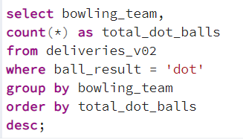
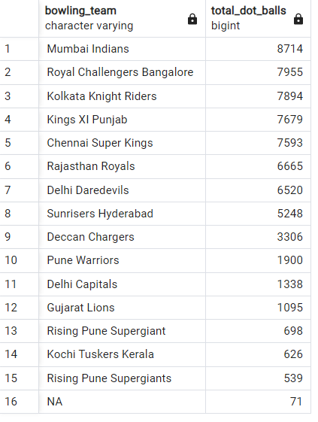
Q5
Write a query to fetch the total number of dot balls bowled by each team and order it in
descending order of the total number of dot balls bowled.
QUERY
OUTPUT

Slide 26
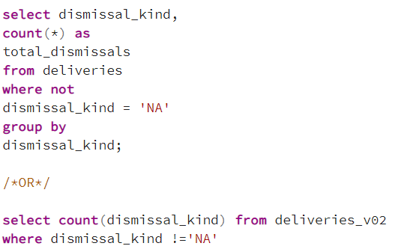
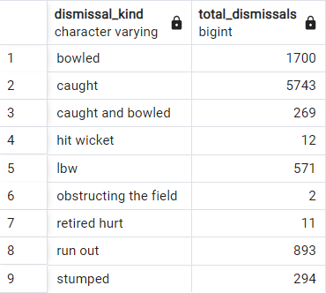

Q6
Write a query to fetch the total number of dismissals by dismissal kinds where dismissal
kind is not NA
QUERY
OUTPUTS

Slide 27
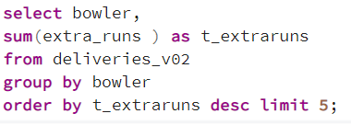
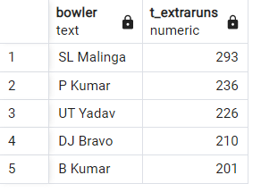
Q7
Write a query to get the top 5 bowlers who conceded maximum extra runs from the
deliveries table
QUERY
OUTPUTS

Slide 28
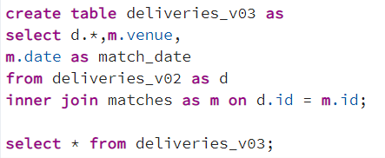
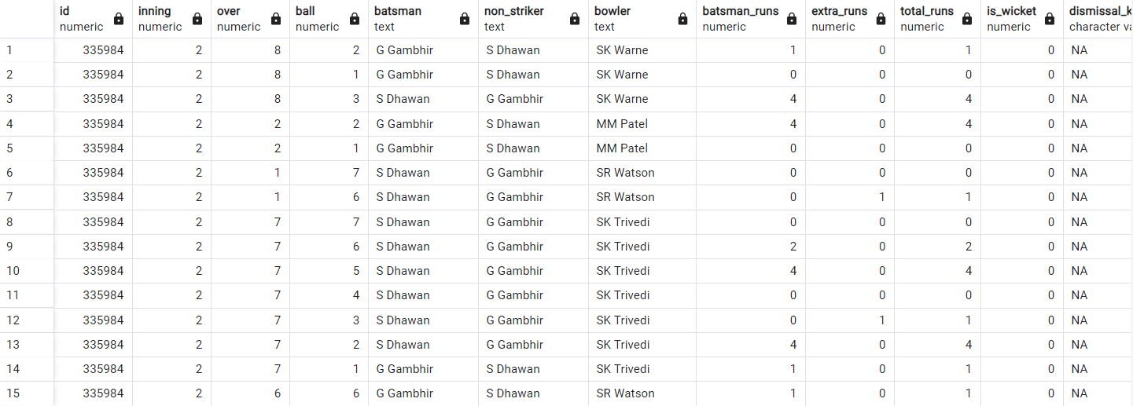
Q8
Write a query to create a table named deliveries_v03 with all the columns of
deliveries_v02 table and two additional column (named venue and match_date) of venue
and date from table matches.
QUERY
OUTPUT

Slide 29
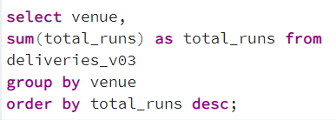
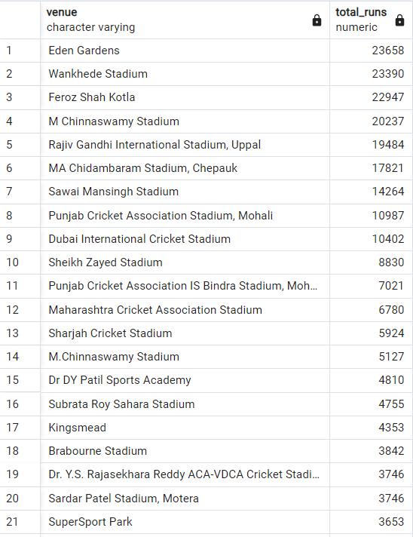
Q9
Write a query to fetch the total runs scored for each venue and order it in the descending
order of total runs scored.
QUERY
OUTPUT

Slide 30
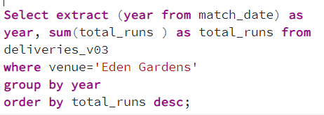
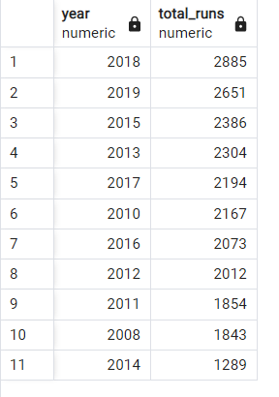
Q10
Write a query to fetch the year-wise total runs scored at Eden Gardens and order it in the descending order of total runs scored.
QUERY
OUTPUT

Slide 31
THANK YOU
Created by : Vaishnavi Gupta
Batch : Data Science (15th June)

